Slide 1
Global energy strategies with low temperature rises An exploration of some possible energy strategies giving a mean surface temperature rise of less than 2 ⁰C by 2100, as required by the 2015 Paris Agreement, using the DECC Global Calculator
Jef Ongena
Laboratory for Plasma Physics, Royal Military Academy, Brussels, Belgium
Chair of the European Physical Society Energy Group
Christopher Watson
Merton College, Oxford University, UK
Chair of the British Pugwash Group
European Physical Society Energy Group Meeting
Brussels
14 September 2016

Slide 2
The story so far
On 23 September 2015, we presented to this group a paper entitled:
Climate change and the DECC Global Calculator
in which we gave a detailed analysis of this software package, which was developed by an international consortium led by the UK Department of Energy & Climate Change (DECC), and was put on their website in 2013.
This public-domain package gives users a tool to devise strategies for mitigating anthropogenic climate change, so as to provide guidance to policy-makers
The user is invited to specify values for about 50 parameters (the so-called ‘levers’) which define a global energy supply and demand ‘pathway’. The software then computes its global emission of GHGs on an annual basis, starting from pre-industrial times, and going up to 2050, using the best available scientific and technical data, and then extrapolates these up to 2100 using a well-defined, but inevitably less precise algorithm.
The package then uses the most recent guidance from the Intergovernmental Panel on Climate Change (IPCC) to forecast the probable resulting global average surface temperature rise from pre-industrial times up to 2100.
The package also reports the lever values proposed by 26 expert organisations, each suggesting one possible ‘pathway’ for the international community to take.

Slide 3
Our previous paper analysed the outputs provided by the Global Calculator for each of its 26 ‘example’ pathways, and tabulated the main components of the primary energy supply, final energy demand and emissions for each pathway.
Very few of these example pathways in fact lead to a temperature rise by 2100 of less than 2⁰C. We therefore set ourselves the task of devising some further ‘representative’ pathways which would meet the demanding targets agreed at the Paris conference in Dec 2015 – less than 2⁰C and preferably less than 1.5 ⁰C. At that time we reported that we had attempted to ‘fine-tune’ three of the DECC example pathways to meet the Paris target, but had failed to do so.
Our three ‘representative’ pathways defined what we regarded as three broadly different global energy strategies – ‘High Nuclear’, ‘High Renewable’ and ‘Intermediate’ – the last of these also being chosen to have a reasonably large amount of Carbon Capture & Storage.
In the present paper we report on our further attempts to find credible ‘compliant’ global pathways. Our initial approach was to consider incorporating the DECC Global Calculator as a sub-routine of an over-riding emission-minimising programme, which would start from one of our three previous representative pathways, and seek adjacent local emissions minima by using a computer-defined minimisation strategy to vary the values of all 50 input parameters. This proved unworkable, and we have now taken a rather different approach.

Slide 4
New developments
Our next approach was to seek guidance from within the Calculator on which parts of the overall system made the largest contributions to the total cumulative emissions. One of the Calculator spreadsheets, with a tab labelled ‘Outputs-Emissions’, has a set of tables showing the annual GHG emissions broken down according to the IPCC ‘sector’ generating that emission.
In broad brush terms, these show that at least up to 2050 the cumulative emissions come overwhelmingly from CO₂, and that the other GHGs make relatively small contributions. The CO₂ contribution coming from fuel combustion and other industrial processes predominates until about 2050, but then falls off, and the relative importance of global agriculture, land use and forestry increases. All other IPCC sectors remain rather unimportant.
Taking this information as a guide, we then looked to see which of the 50 levers might be expected to have a significant influence on this second sector. From the descriptions given in the Calculator in the tab labelled ‘Detailed lever guides’ it was clear that the relevant levers were in the range numbered 33-42. The titles of these levers, and the DECC explanation of the significance of integral values of the levers are given in two slides later on.
We therefore did a series of runs of the Calculator, each one starting from one of our three previous ‘representative pathways’ and then making systematic variations in the lever values in this sector, choosing to allow lever values to vary in the range 3-3.5. We recognised that a lever value of 3 is regarded by DECC as meaning ‘requiring a very ambitious level of effort’, and 4 as ‘requiring effort at the extreme upper end of what is physically possible’.
The results of this exploration are presented in the ‘Consolidated Summary’ slide below, and discussed in the ‘Commentary’ which follows it. But before that, we should give some comments on the policy challenges presented by the Calculator, and on the way in which it computes the emission values resulting from the user’s lever choices, and then uses these to derive the resulting global surface temperature rise.

Slide 5
The policy challenges set by the Global Calculator
The 50 levers of the Calculator are evenly divided between topics relating to energy supply and its end use. The energy supply levers require the user to make a strategic decision on the relative sizes of the nuclear, renewable and CCS components of the global energy mix. Unfortunately, (as we spelt out in an earlier paper on UK energy policy), all three components are threatened by potential ‘show-stoppers’ – issues which might make elements of that policy decision technically or economically non-viable. In this paper we again recommend that governments should pursue all three alternative strategies in parallel until it is clear that at least one pathway is open – ie that the relevant technology is already available or will be soon enough, and that the social implications of that pathway are broadly acceptable to the public.
The ‘end use’ levers present an equally daunting challenge, since (as our preceding paper showed) making socially uncontroversial choices inevitably leads to temperature rises by 2100 well above the Paris targets. This paper shows that there are nevertheless lever choices which just permit these targets to be met. But the debate is only beginning over their social acceptability. To assist in this debate we provide extracts from the Calculator on the implications of choosing integral lever values in the range 3 to 4.
The Calculator makes it clear that the momentous Paris decision is seriously flawed, because it commits the signatory nations to working towards an ill-defined target – keeping the global mean surface temperature rise below 2ºC at a date which is so far into the future that precise predictions are impossible. At best, the experts can estimate probabilities, in some cases with rather wide error margins. Accordingly, the Calculator presents a range of temperature rise estimates within which the value probably lies for that pathway, and the user is invited to select a ‘best estimate’ within that range. In this paper (as in the outputs of the Calculator) we present both the mid-point of the range, and the value which is reached in 50% of model runs.

Slide 6
The meanings of high integral lever values
Lever No | Lever Title | Level 3 description | Level 4 description
33 | Calorie consumption | Calorie consumption reaches 2300 kcal / person / day by 2050: there will be still a significant increase globally, but the current trend is slightly reduced | World calorie consumption reduced to 2100 kcal / person / day by 2050: still a healthy diet. It could involve some redistribution of food consumption between developing & developed countries
34-35 | Meat consumption and type of meat | Assumes a low meat consumption (162 kcal of meat / person / day) meeting the WHO guidance for a healthy diet, but adjusted to give average of 40% red and 60% white meat) and allowing 10% waste. | Assumes diets with very low meat consumption of 15 kcal of meat / person /day, with 25% red meat and 75% white meat, but allowing vegetarian diets and meat alternatives (e.g., soy meat substitutes, yeast-based meat etc.). This involves an unprecedented change in dietary preferences worldwide.
36 | Crop yields | Requires an increase in global crop yields by about 60% by 2050 - ie a continuation of past yield growths for grains. This will require better crop varieties, irrigation, higher use of fertilisers, etc. | Requires an extreme yield growth of 120% by 2050. This would need a substantial use of biotechnology, a high increase in photosynthetic efficiencies, technology transfer, etc
37 | Land use efficiency | Requires an increase in agro-forestry-pasture synergies and best farming practices, e.g., crop rotation, dual cropping, co-cropping, no tillage technologies., meaning that10% less land is needed for food/livestock/bioenergy. | Means climate-smart agriculture and high levels of integrated agricultural land use management (e.g., dual/triple cropping). It assumes best practice in agro-forestry-pasture synergies, and release of 30% of agricultural land.
Calories consumed Means a calorie consumption growth from 2140 kcal / person / day in 2011 to approximately 2300 kcal / person / day by 2050, which is similar to the FAO forecast by Alexandratos & Bruinsma (2012), after adjustment for excluding food losses. In this trajectory, there will be still a significant increase of food consumption globally, but the current trend would be slightly reduced due to, e.g., population and consumption peaks in some countries.
Reduce world calorie consumption slightly from 2140 kcal / person / day in 2011 to 2100 kcal / person / day by 2050, which is a target for a healthy diet (2200 kcal / person / day for men, and 2000 kcal / person / day for women). However, this could also involve redistribution of food consumption, where some developing countries could increase food consumption (e.g., by reducing poverty) whilst some developed countries could reduce consumption (by tackling obesity issues). Overall, this is an extreme target, given that values below this global average would result in higher undernourishment rates

Slide 7
Lever No | Lever Title | Level 3 description | Level 4 description
38-39 | Livestock yields | Means a 50% increase in concentration of grass-fed livestock (animal density), a 15% increase in feed conversion ratio, and a large increase in feedlot systems up to 15% in 2050 for cattle and 8% for sheep and goats. This means a high use of conventional animal genetic improvements, pasture rotation management, technology transfer to developing countries and capacity development programmes. | Assumes an 80% increase in concentration of grass-fed livestock (animal density), 20% increase in feed conversion ratio, and high increase in feedlot systems up to 30% in 2050 for cattle and 10% in 2050 for sheep and goats. This This also assumes extensive use of biotechnology, and strong technology transfer from developed to developing countries in order to leap-frog the learning curves for higher productivities.
40-41 42 | Bioenergy yields Surplus land (forest & bioenergy) | Assumes an increase in the use and yield of more efficient energy crops, with a total of 120% by 2050. This yield growth is expected through an expansion of some new biofuels technologies, e.g., lignocellulosic bioethanol and Fischer-Tropsch biodiesel. In this level, crops with high energy performance would substantially increase their share in the global market. Means that the remaining land would be allocated for 40% natural regeneration and planted forests, and 60% for a limited expansion of energy crops. | Represents an extreme increase of bioenergy yields and focus on very high efficient energy plants, with a total increase of 220% by 2050. This is based on advanced fuel technologies, biotechnology, state-of-the-art farm management, and further use of irrigation and fertilisers. This level assumes highly efficient energy crops (e.g., sugarcane, oil palm, switchgrass, napier grass, miscanthus) would dominate the market and consequently also increase the average yield of bioenergy crops. Assumes that the remaining land would be allocated 100% for a limited expansion of energy crops. This would give a linear growth rate of 22 million ha / year, up to an estimated 300 EJ of bioenergy by 2050, defined by IPCC as an ‘extreme’ global bioenergy potential.

Slide 8
Problems in forecasting temperature rises
The calculation of future emissions is relatively straightforward, since it is driven by technical parameters which have been gathered carefully by the Global Calculator team
By contrast, the derivation of future temperature rises from the calculated emission values is fraught with difficulties. Global climatology is not an exact science, and it relies on computer models which have some difficulty in making accurate predictions for even three days into the future, let alone many decades. The IPCC has commissioned runs of over a hundred such models, in each case taking the same start date and emissions data and has assembled plots of the outputs, such as that shown on the next slide, which exhibit all too clearly the variability of the models, and the growth in the uncertainty of their predictions as the forecast reaches further into the future. However the output data from these ensembles can be statistically analysed to yield a probability distribution for each year, with mean values and variances, and hence to plot the envelope of such values bounded by a specified probability. An example of such a plot is shown in the next slide. The boundaries are typically rather smooth curves, and analytic approximations to them are fed into the Calculator. As these two slides show, there is a certain break at the junction between the part of the plot relating to historical data (for which the correct values are known) and the part containing only forecast data, reflecting a certain bias in the model as well as forecasting variability. The climate research community is seeking to reduce both the bias and the forecasting variability by improving their models. In the second slide, which is a Calculator adaptation of an IPCC presentation, the grey band relates to CO₂ emissions only, and the pink band seeks to make allowance for non-CO₂ GHGs.
To reduce all this complexity to manageable form, the Calculator has defined two alternative methods of calculating the temperature rise, which it calls:
“Interactive CO₂ with representative non-CO₂ gases” and
“Interactive CO_{2 ,} CH_{4,} N₂O, and SO₂ only”
The former method uses the pink area in the slide to determine the upper and lower bounds. This has been constructed by the climatologists to include an allowance for the contribution of non-CO₂ gases. The latter uses the grey area, which relates to the CO₂ contribution only, but it then adds in a separate calculation for the principal non-CO₂ gases. The details can be found in lines 42-57 and lines 69-101 of tab labelled ‘Climate Impacts’. In both methods, the user has an option B (in lever 51) to specify that the width of the range should be expanded by one standard deviation by multiplying by 1.645, to reflect the uncertainty in the methodology.
The Calculator documentation makes it clear that in the web tool version, only the second method is implemented and option B is taken. The first method is only mentioned in the spreadsheet version of the Calculator , and (as the Spreadsheet User Guide explains on p42 )“it is provided only as a reference calculation for the interested spreadsheet user within the spreadsheet”.
The statistical analysis of the output data from runs of many relatively independent computer climate models has made it possible to make statistical statements about the probabilities of various results, such as the Calculator statement in the Outputs-Emissions tab that “Cumulative emissions of 3010 Gt of CO₂ are associated with 50% of climate models achieving a 2⁰C temperature change” (the corresponding figure for 1.5ºC being given as 2260 Gt). These figures are also given in the web tool in the drop-down panel on emissions on the overview page)

Slide 9
Outputs of forecasts commissioned by IPCC from a range of independent climate models using specified emissions from 2005 to 2050
EE
The heavy black line summarises historical observations: the ensemble of coloured lines represent forecasts by individual climate models, all set to start at 2005.
(Source IPCC 5th Assessment Report WG1 AR5 page 87)

Slide 10
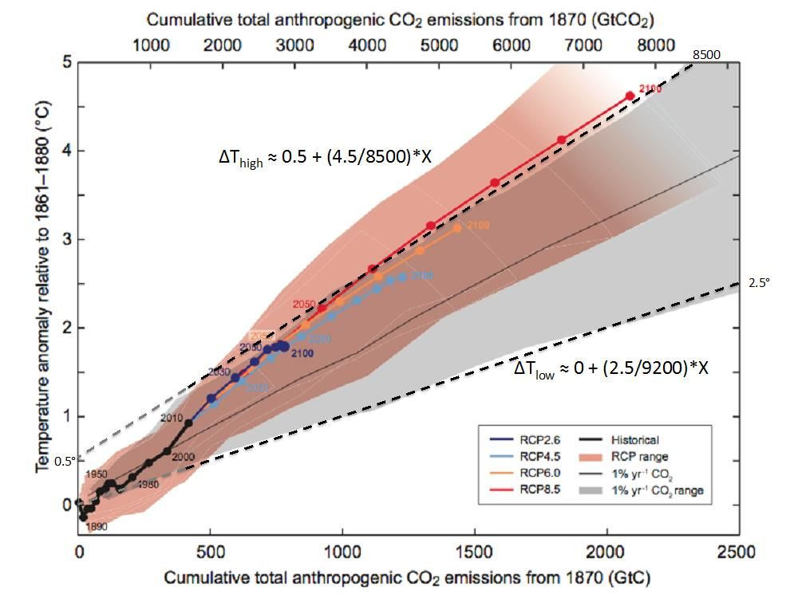

Slide 11
Consolidated summary of Calculator inputs & outputs 9/9/16

Slide 12
Commentary on these results
All the specified variations suggested in this paper give a decrease in the cumulative global emissions up to 2100. The largest decrease comes from variation 5 (which leads to a reduction in the consumption of meat generally and of red meat in particular). However significant decreases also result from all the other agriculture-related variations chosen.
It is not clear what claim we should make about our success in meeting the Paris Agreement targets. If one takes the criterion that to meet the 2⁰C target the cumulative emissions at 2100 should be less than 3000 Gt, then all the pathways that we suggest meet that criterion. If one requires the temperature at the mid point of the range determined by the Calculator to lie below 2⁰C, then only the three ‘Variation 5’ pathways meet the criterion, though all the rest are very close.
We certainly do not claim that the variations that we have chosen give the only possible pathways to meet the Paris targets. There is scope for considerably more exploration on intermediate values, or combinations of several levers instead of our (mostly) single lever variations in value. Such exploration may be necessary to address objections from the general public to the implications of our high-value lever choices.
If the Calculator is to find more users, both among energy policy experts, and by policy makers who want to assess conclusions from it, there is a need for considerably more work to be done on the Calculator software package, both to address gaps in its methodology and to make inputs more user-friendly, as noted in our previous paper. The weaknesses in its treatment of bioenergy, energy storage and the use of inter-connects need to be remedied.
Notwithstanding these negative points, we commend the Calculator to policy makers and the general public alike, as a valuable tool for putting real numbers into debates on energy policy.

